Slide 1

Housing Needs Assessment
Housing and Infrastructure
Madison County, Montana

Slide 2
CONTENTS
Housing Demand
Suitability Map
04
01
Countywide Comparison
02
05
Future Needs
Strategies for the Future
03
Stakeholder
06
07
Questions

Slide 3
Housing Demand & Supply

Slide 4
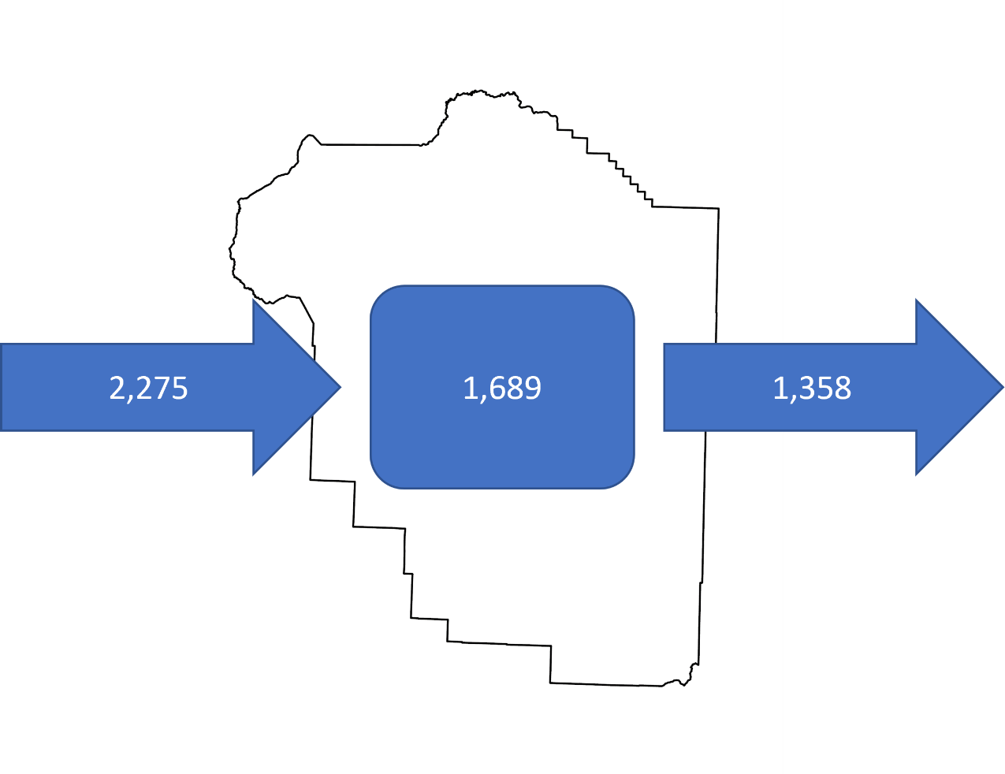
Commuting Patterns for Madison County Residents
Commute into the County: 2,275
Commute out the County: 1,358
Stay in the County: 1,689
Net Import: 917

Slide 5
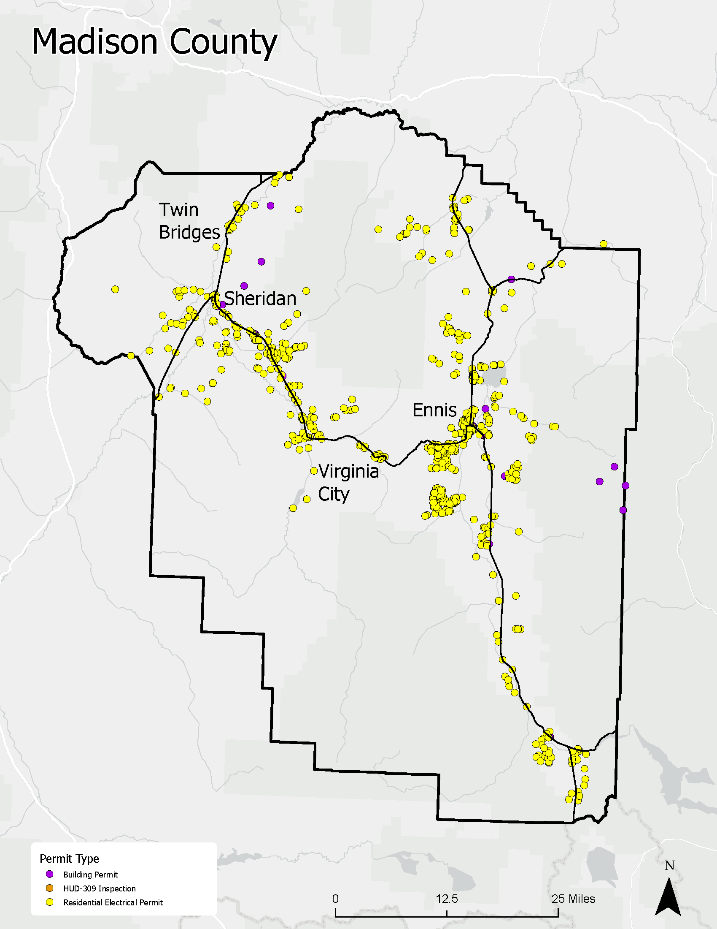
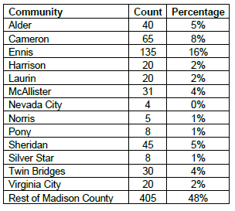
Map showing residential building starts in Madison County from 2019-2021
Building Permits: 65
Electrical Inspection: 829

Slide 6
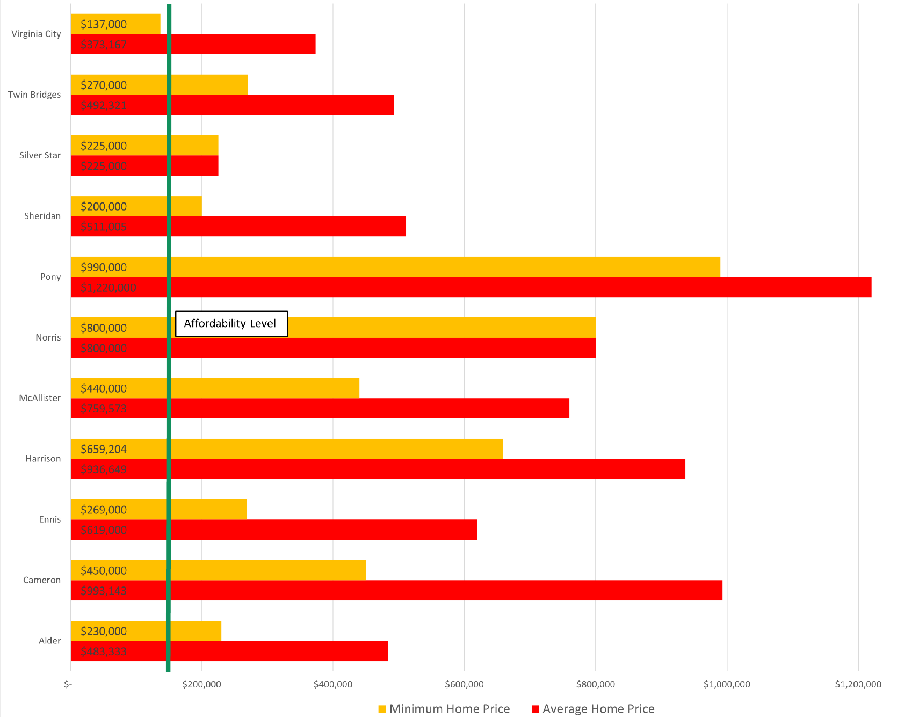
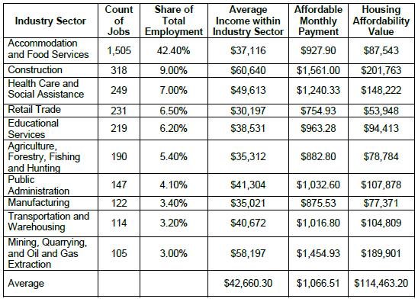
Table of wages and affordability factors

Slide 7
Countywide Comparisons

Slide 8
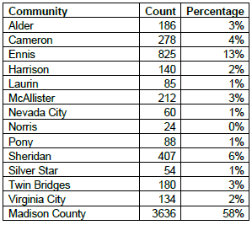
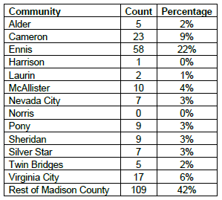
Residences by Community
Short Term Rentals by Community

Slide 9
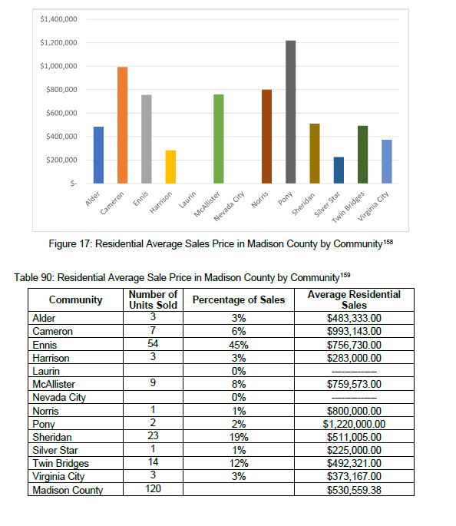
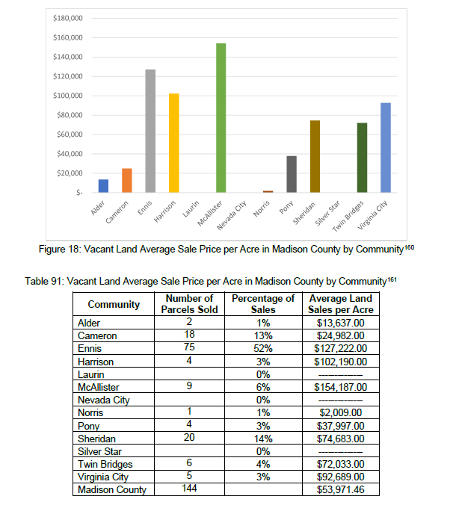

Slide 10
Stakeholder Meetings

Slide 11
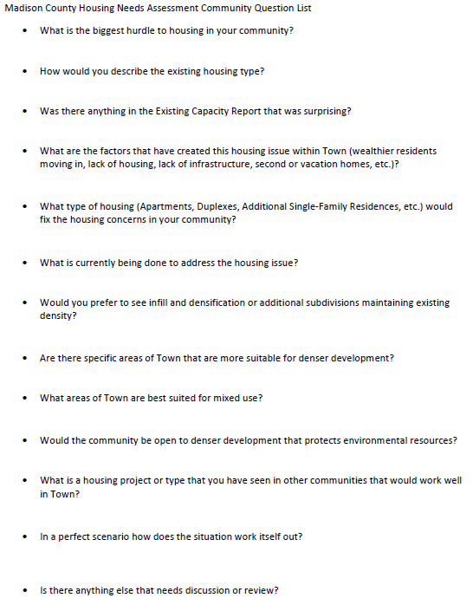
Stakeholder Meetings were held with:
Ennis
Harrison (survey only)
Twin Bridges
Sheridan
Virginia City

Slide 12
Harrison: Key Information
Wastewater is the biggest factor impacted housing
Generally seem okay with duplexes to keep town small
Working on a PER to expand sewer system
Ennis: Key Information
Price was major concern
Availability of Land
Impacts from Short Term Rentals
Ennis is working to update their zoning code
Sheridan: Key Information
Price and availability of land
Availability of services to the south
Estimated that needed approximately 10 units as a good start

Slide 13
Twin Bridges: Key Information
Availability of Land and Price
Working on several projects
Potentially a housing land trust
Keeping residents struggling with housing in the community
Virginia City: Key Information
Rehabbing Old Buildings
Concerns with the impacts of the zoning code
Looking to develop a list of property and the next steps forward
Working on community educational efforts

Slide 14
Suitability Map

Slide 15
Suitability Map
Created using publicly available data
Used to identify areas most suitability for residential development based on the following:
Proximity to Roads
Wildland Urban Interface
Proximity to Fire Stations
Floodplain
Slope
Conservation Easements and Public Lands
Watercourse Setbacks
Grazing Areas exceed 50 acres
Central Infrastructure
This map should not be used to direct any project solely and should be used to contact and work with willing land owners.

Slide 16
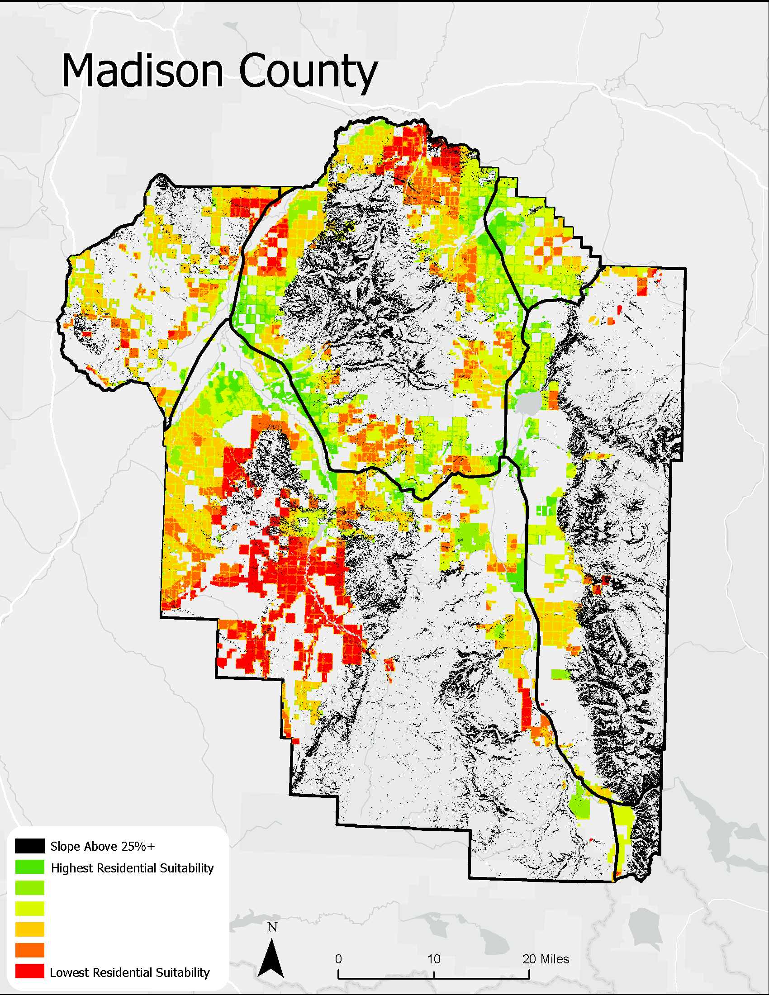
Suitability Map for Residential Development in Madison County, Montana
Areas in green are more suitable based on the criteria on the last slide
Areas in red are less suitable but this does not mean that residential development cannot take place here.
Blank geometries were used to make the analysis more objective

Slide 17
Future Needs

Slide 18
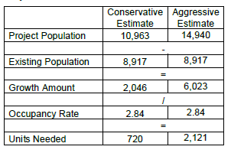
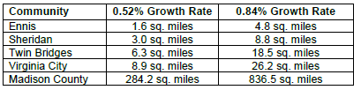
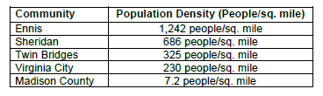
Population Projections
Land Needed to Accommodate Projected Growth
Population Densities Current

Slide 19
Strategies for the Future

Slide 20
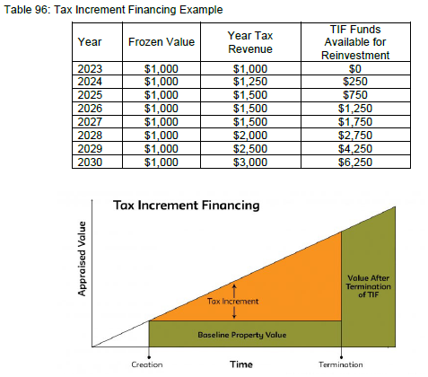
Funding Strategies
It is well known that there will need to be a large financial investment to start mitigating housing concerns
These funds can come from various sources and making contact with the appropriate agencies is Madison County’s best chance to begin securing these funds
Tax Strategies
Tax Increment Financing Districts
Targeted Economic Development Districts

Slide 21
Funding Strategies
It is well known that there will need to be a large financial investment to start mitigating housing concerns
These funds can come from various sources and making contact with the appropriate agencies is Madison County’s best chance to begin securing these funds
These are the longest term agencies that fund both private and public housing projects
Grants
US Department of Housing and Urban Development
US Department of Agriculture: Rural Development Program
Montana Department of Commerce
Headwaters Resource, Conservation, & Development

Slide 22
County Initiated Projects
Housing Advocacy Position
Potential for a staff person or contracted person to stay up to date on all housing grants and solutions
County Owned Housing
The County could develop staff housing through a community land trust. This would allow them to house employees therefore removing competition in the market and have a bargaining chip to hire and retain quality candidates.
Process for Evaluating Projects
Creating a numeric or objective criteria for evaluating project will provide clarity to the development community and streamline evaluation processes.
Infrastructure Strategy
Use the PERs and information gathered in the Infrastructure Survey to prioritize projects. Continue the infrastructure survey into the future.

Slide 23
County Initiated Projects Cont.
Incentivize Diverse Housing and Zoning
The County could identify areas that are best suited for increased density or housing. They could zone these areas and provided tax or funding incentivizes to get these units built. This methodology would need strong partnership with citizens and the development community.
Community Housing Trusts
Land that is owned by an organization that would allow for maintained affordability. The County could provide resources, contacts, or land to these projects. This will need further evaluation but this is a well used model. Twin Bridges is working to potentially develop a Community Housing Trust.

Slide 24
Questions?

Slide 25
Scott Hazelton, CFM
shazelton@hyaliteeng.com

